Slide 1



IMDB Exploratory Data Analysis
- Lakshmi Aravind

Slide 2

Exploratory Data Analysis
Problem Statement and Approach
Data Description
Data Loading
Deriving Best Director, Genre, Actor based on their Movies, Revenue, Ratings & Metascore
Conclusion

Slide 3
Problem statement and approach
Here given is the IMDB database of 1000 movies for the last 10 years (2006-2016). Identifying the characteristics of movies that earn:
More Revenue
Popularity based on rating (IMDB Rating)
Also, We need to identify the strategy that could be used in investing in movies to gain maximum profits based on various criteria.

Slide 4
Data description
The Dataset is derived from IMDb which consists of 1000 movies from year 2006 to 2016.
The Dataset consists of information such as Movie Title, Genre, Director, Actors, Ratings, Revenue etc.
The Dataset Comprises of 1000 rows and 12 columns

Slide 5
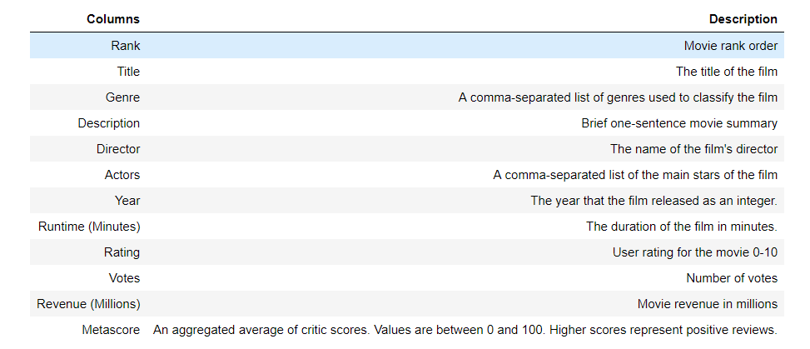
Data Definition
The DATA SET includes Movies data from 2006 – 2016. It provides full data of Movies like Director, Rating, Genre, Revenue Etc.,

Slide 6
Steps Followed
First, Understand the dataset
With the help of pandas profiling, find which columns require preprocessing.
Clean up the dataset.
Identify several questions to find out the relationship of Genre, Director and Runtime of movies against Revenue, Rating and Metascore.
Explore the impact of Director on a movie’s Revenue, Rating and Metascore.
Explore the impact of Runtime of a movie based on length
Explore the correlation between Revenue, Rating and Metascore.
Draw conclusions from the findings from all the exploration.
Find out actionable insights based on the findings.

Slide 7
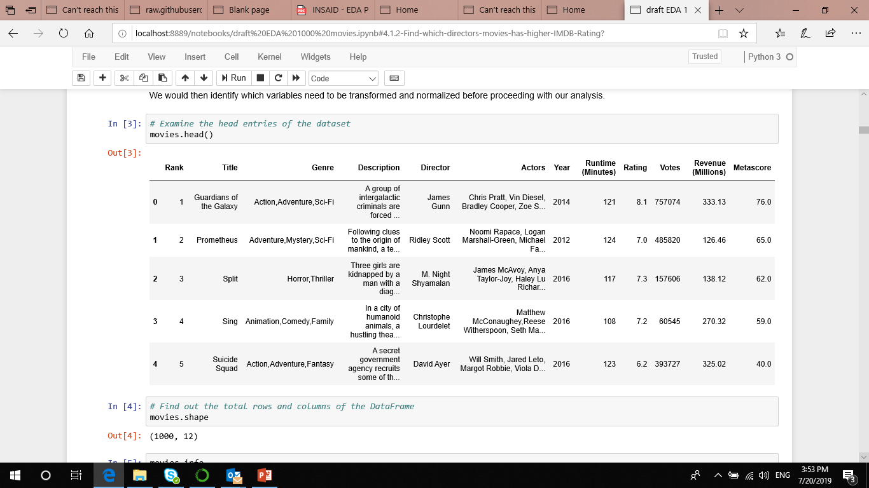
Data Loading

Slide 8
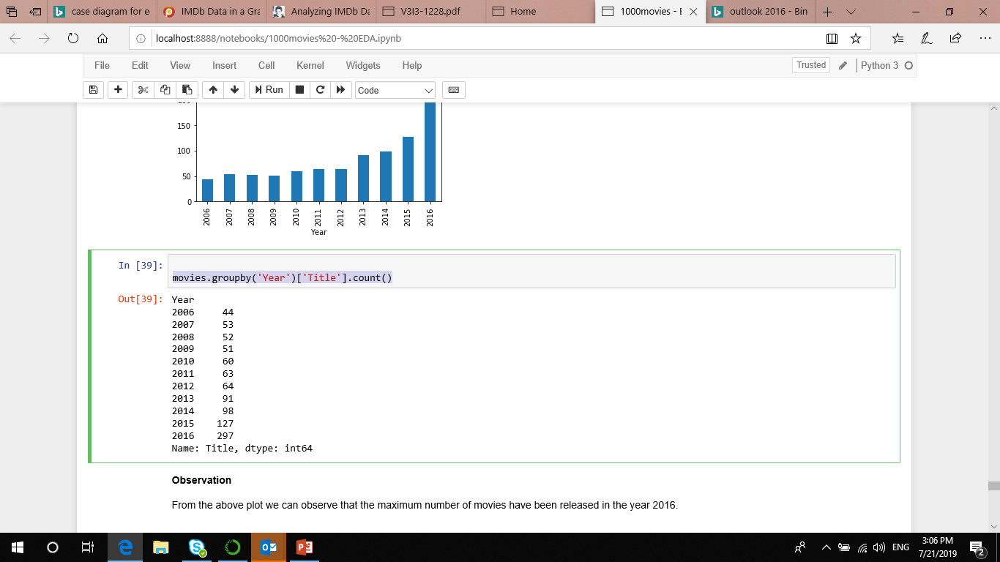
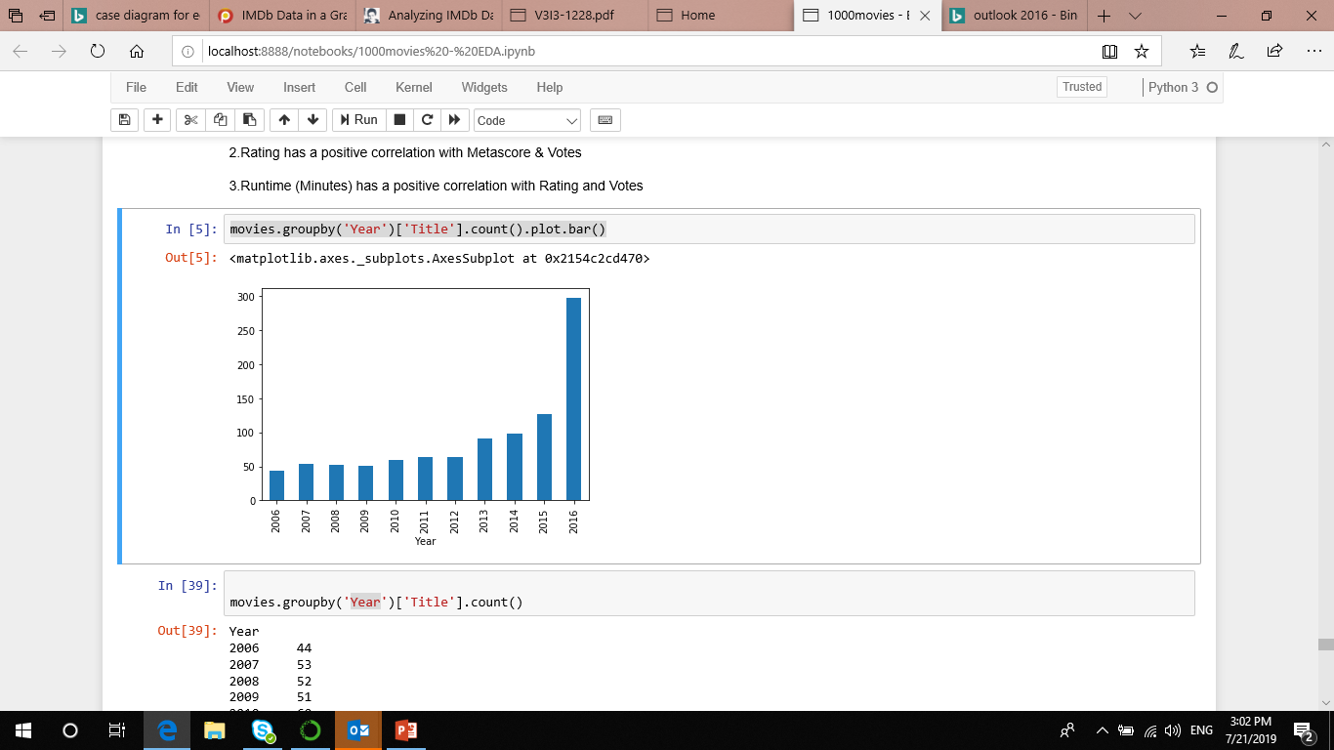
Which Year had higher Number of movies released
movies.groupby('Year')['Title'].count()
2016, Year in which higher Number of movies released during the period 2006- 2016

Slide 9
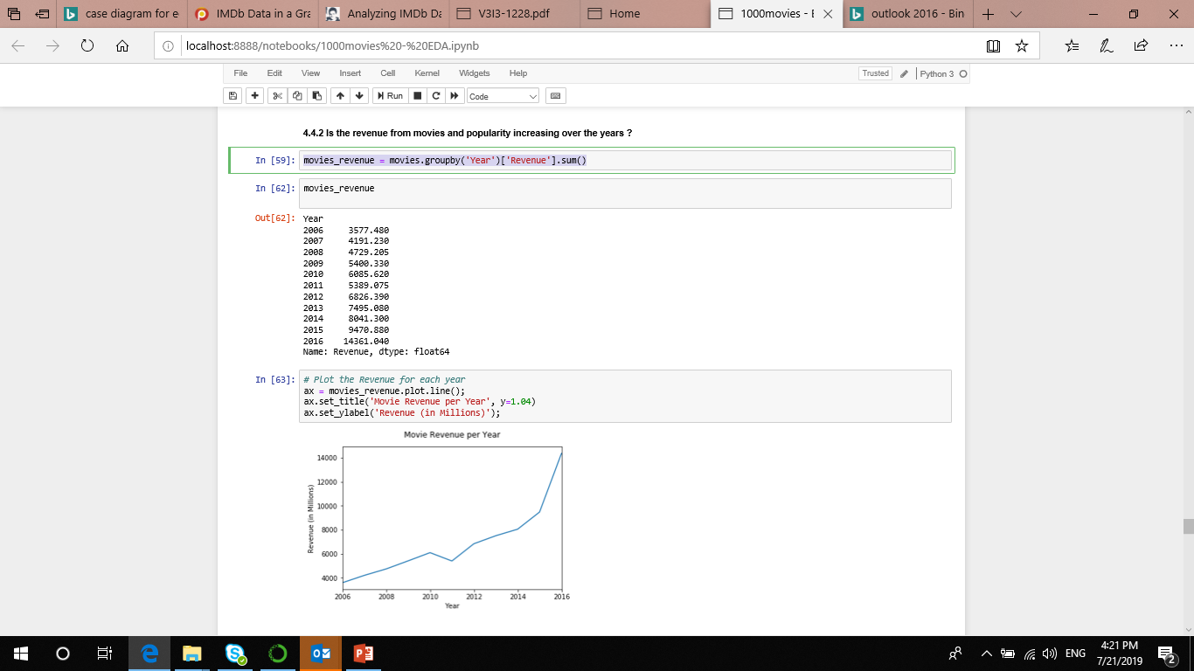
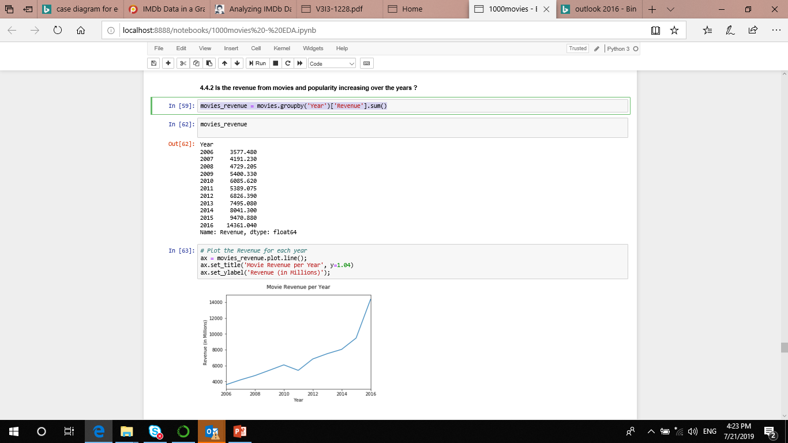
Which Year had higher revenue generated
movies_revenue = movies.groupby('Year')['Revenue'].sum()
2016, Year in which revenue generated is high

Slide 10
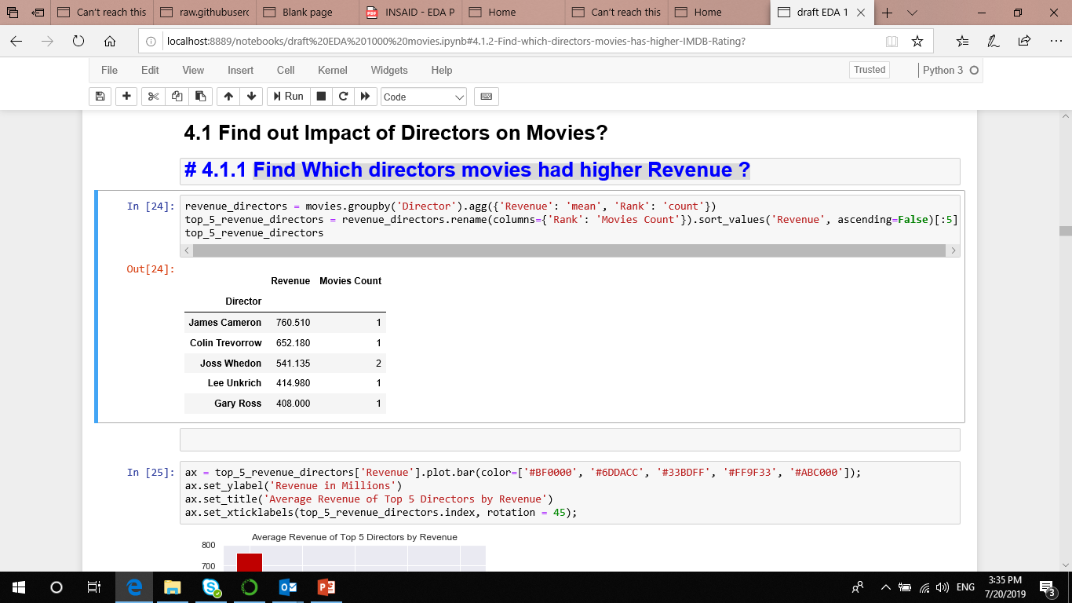
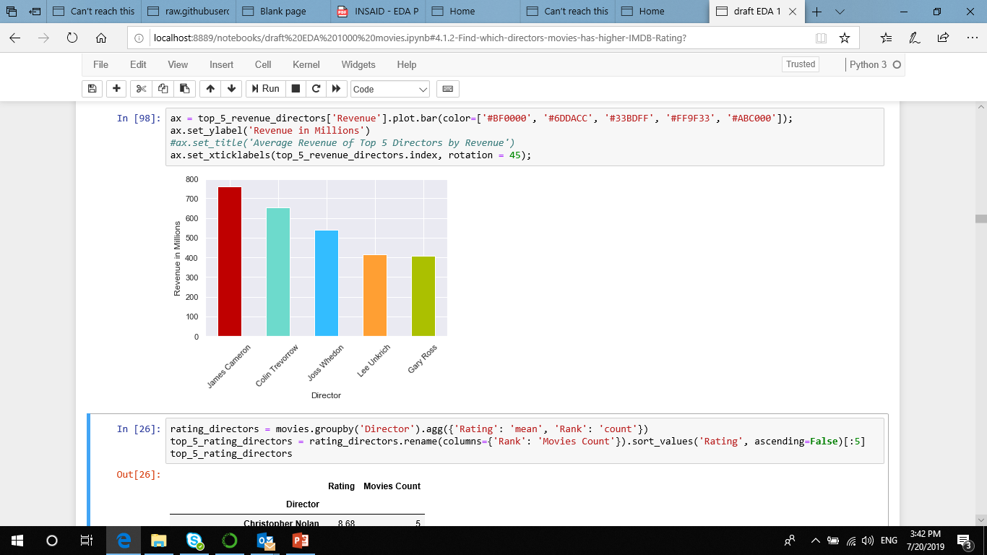
Which directors movies had higher Revenue ?
revenue_directors = movies.groupby('Director').agg({'Revenue': 'mean', 'Rank': 'count'})
top_5_revenue_directors = revenue_directors.rename(columns={'Rank': 'Movies Count'}).sort_values('Revenue', ascending=False)[:5]
top_5_revenue_directors
James Cameron is the director who has earned the highest average revenue

Slide 11
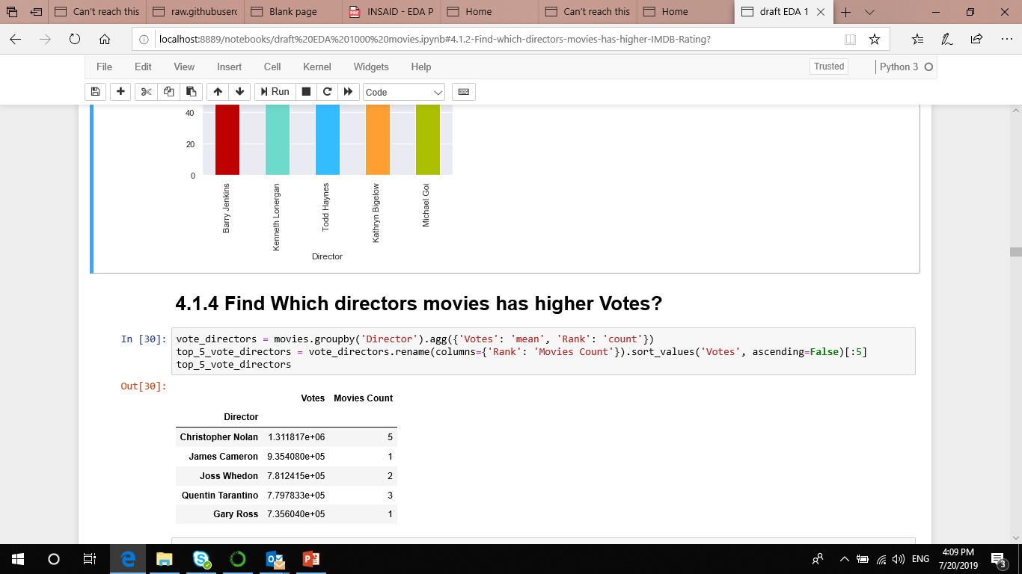
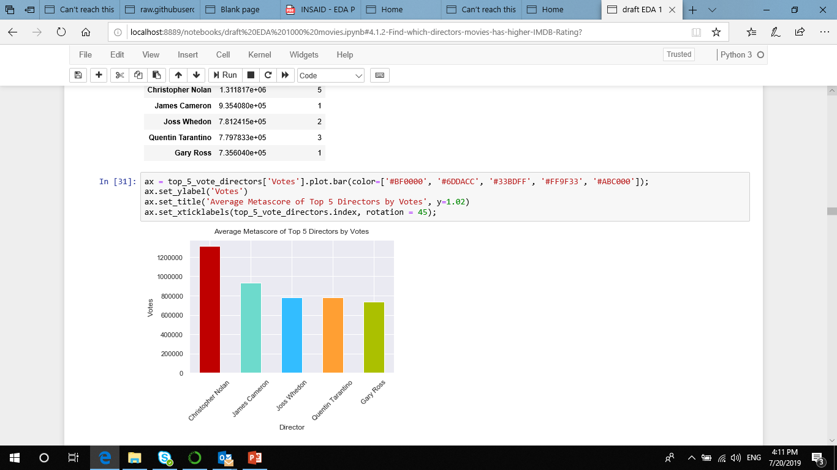
Which directors movies has higher IMDB Rating ?
rating_directors = movies.groupby('Director').agg({'Rating': 'mean', 'Rank': 'count'})
top_5_rating_directors = rating_directors.rename(columns={'Rank': 'Movies Count'}).sort_values('Rating', ascending=False)[:5]
top_5_rating_directors
Christopher Nolan is the director who has earned the higher Votes

Slide 12
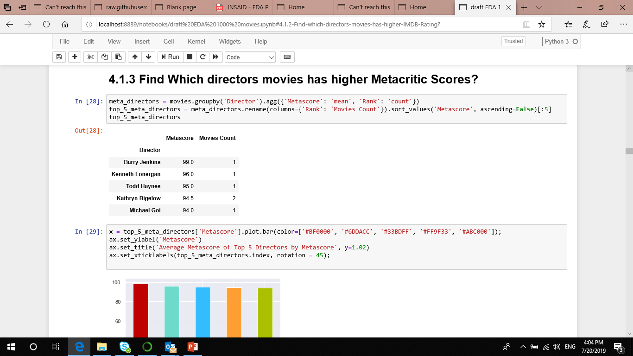
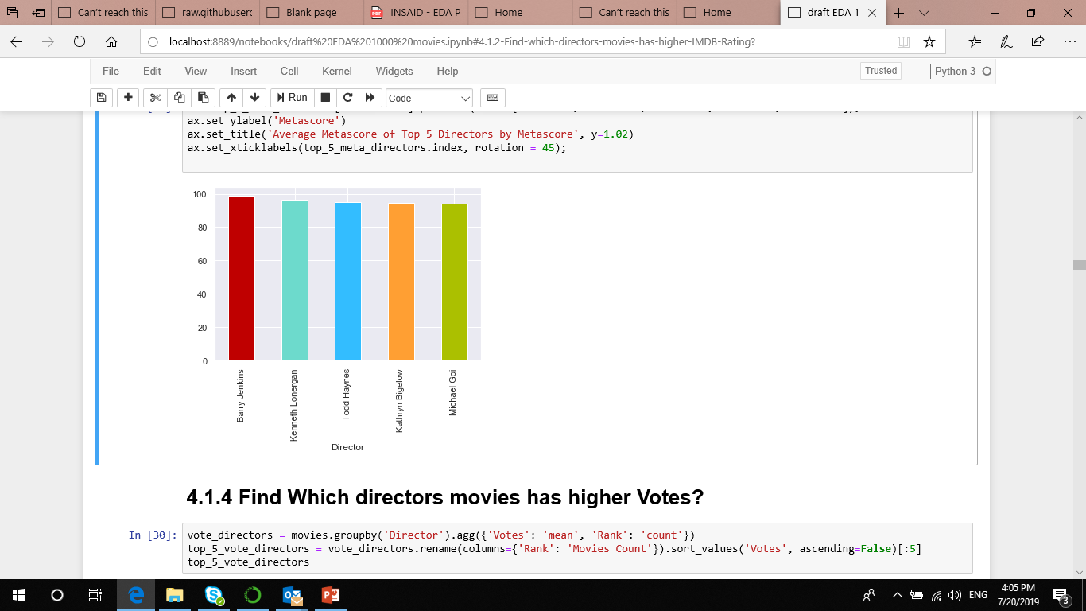
Which directors movies has higher IMDB Votes ?
vote_directors = movies.groupby('Director').agg({'Votes': 'mean', 'Rank': 'count'})
top_5_vote_directors = vote_directors.rename(columns={'Rank': 'Movies Count'}).sort_values('Votes', ascending=False)[:5]
top_5_vote_directors
Barry is the director who has earned the higher Metascores

Slide 13
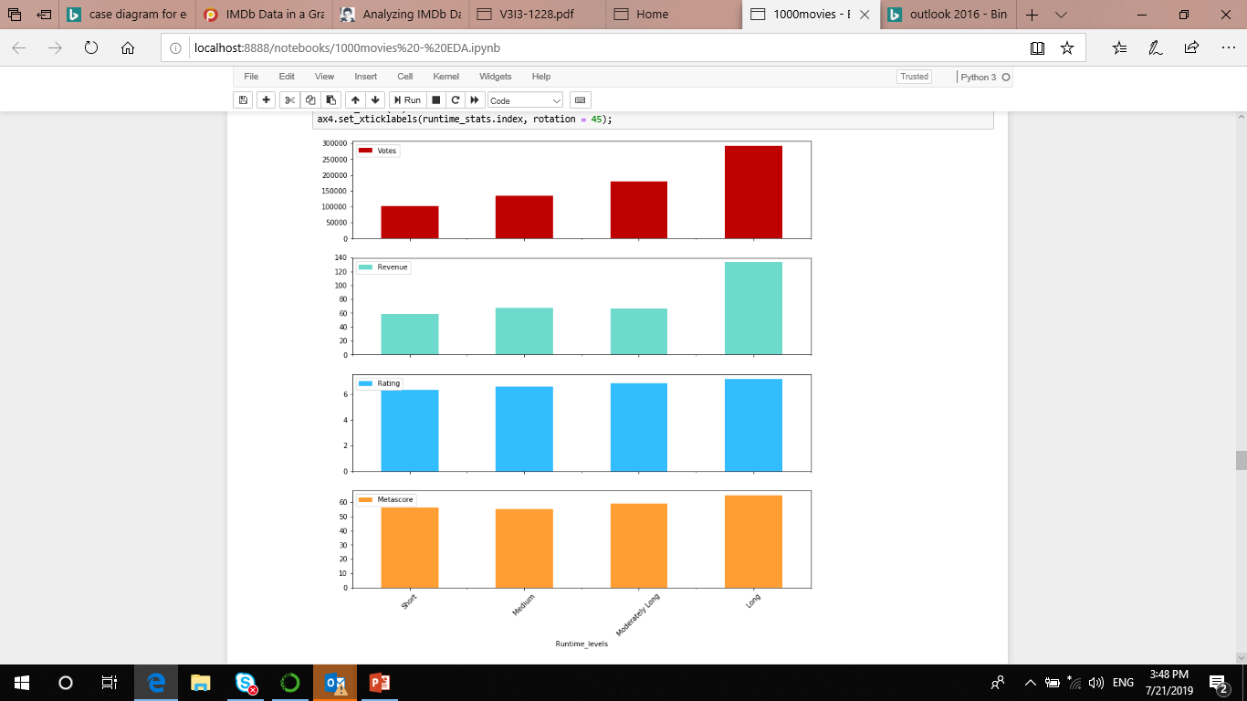
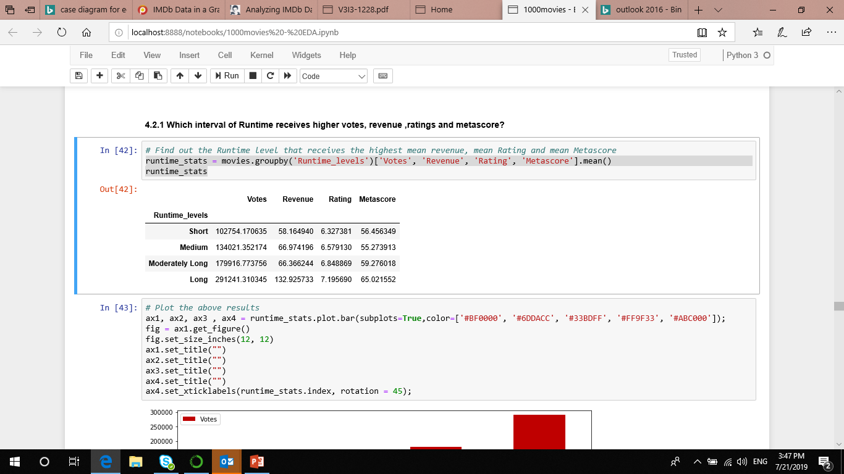
Which Runtime movies has higher IMDB Votes ?
runtime_stats = movies.groupby('Runtime_levels')
['Votes', 'Revenue', 'Rating', 'Metascore'].mean()
runtime_stats
It should be noted that, movies with Runtime (greater than 123 minutes) beats other movies in terms of Revenue by a significant margin. Also these movies earned good metascores as well.

Slide 14
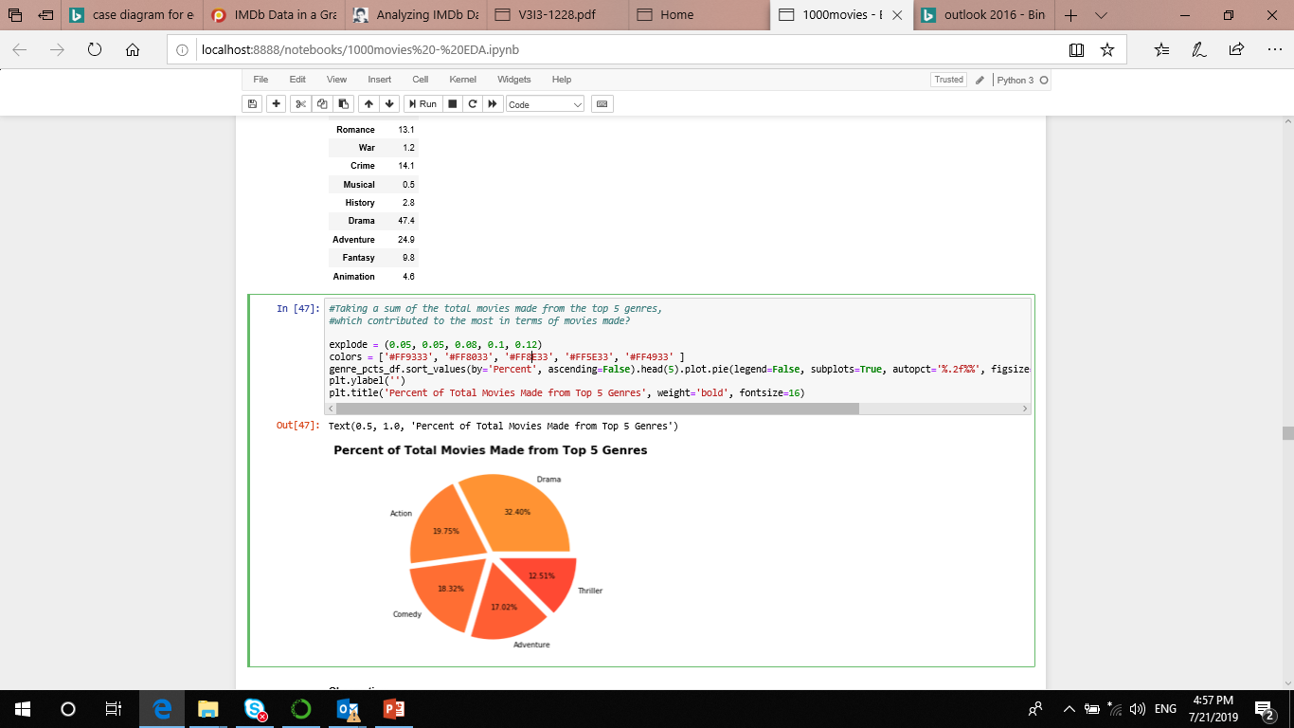
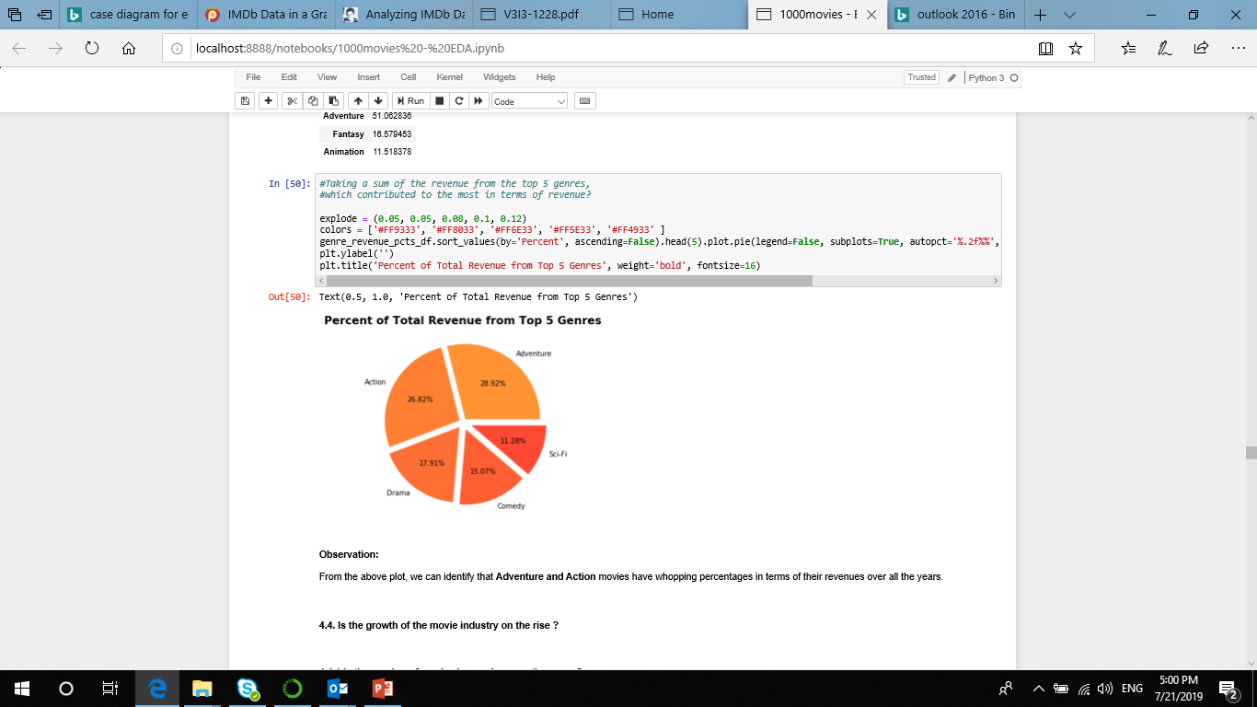
Which Genre released more,with higher revenue ?
Top 5 Genres are Drama ,Action and followed by Comedy, Adventure or Thriller
Adventure and Action movies have whopping percentages in terms of revenues

Slide 15
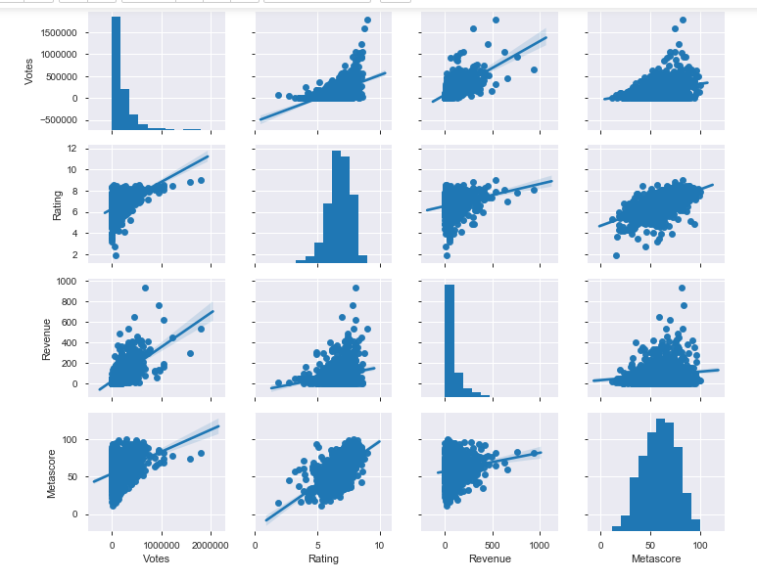
Relationship between votes, Rating, Revenue and Meta_score

Slide 16
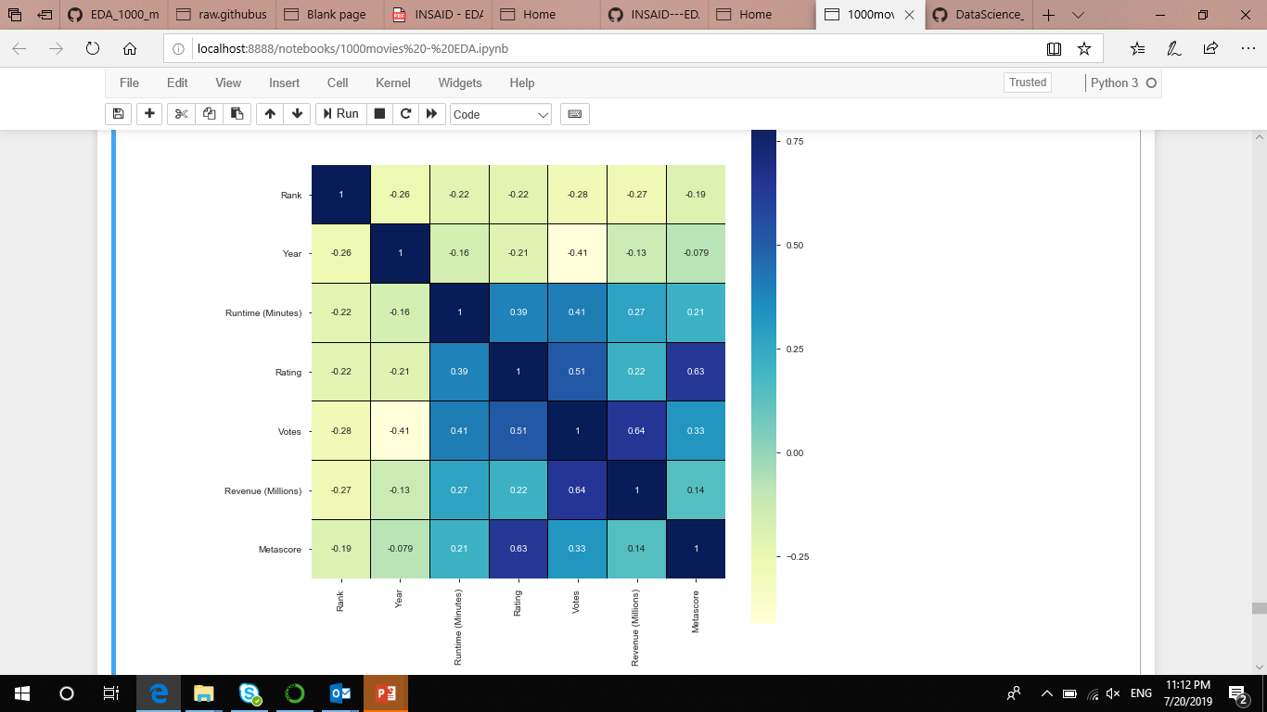
Establish correlation between all the features
using heat map
Votes has a high positive correlation with Revenue
also Rating has a positive correlation with Metascore &
Votes and Runtime (Minutes) has a positive correlation with Rating and Votes.

Slide 17
Conclusion
Year 2016 has the most no of movie released and has the highest revenue generated
Director who has earned the highest average revenue is James Cameron. However he has directed only 1 movie in the 10 year period.
Christopher Nolan's movies are the most popular among viewers as the average rating for his movies is the highest in the 10 year period and he infact had gained highest number of votes from viewers.
Votes has a high positive correlation with Revenue also Rating has a positive correlation with Metascore & Votes and Runtime (Minutes) has a positive correlation with Rating and Votes.
Genre Adventure, Action, Comedy, Drama, Animation genre movies, have generated high box office revenues.
Metascore and Runtime (Minutes) is directly proportional to Rating of the movies.
Impact of Rating, Votes, Metascore and Runtime (Minutes) on the Revenue.

Slide 18
Actionable Insights
Produce multiple movies with best features - The movie industry is growing very fast. More movies are released year on year and the competition is very high and the revenue is distributed among many movies.
Produce movies with active directors - those people who directs multiple moderately high budget movies. For instance, Christopher Nolan movies is certain to bring in more Revenue, Rating and Metascore.
Produce movies that have Long runtimes - Runtime greater than 2 hrs.
Produce movies with 3 Genre combination - Include a mix of Drama, Animation, Adventure, Action, Thriller. The movies should relate to audience with real life incidents, should move them to the edge of the seats and should enhance their imagination.
Produce movies that will satisfy both People and Critics - These movies will earn higher Revenue

Slide 19
Thank You!

